Slide 1
Introduction to Active Directory
Kevin Shan

Slide 2
Active Directory
Active directory is a Windows Server directory service that allows you to manage your server.
Active directory contains information on:
Users and computers in your network
Permissions for users
Details for each user (like passwords, information, etc.)
Notes:
Administrator
Cyb3rPatr1ot!@

Slide 3
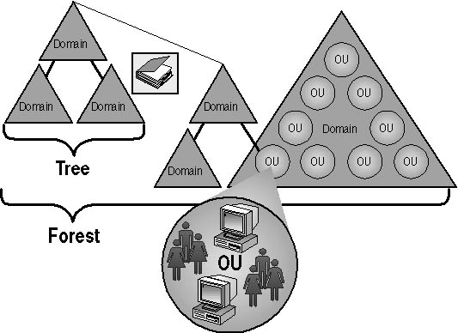
Structure
There are domains, trees, and forests in Active Directory.
Domain: group of computers, users, and objects (management)
users, computers, applications, printers, shared folders
Organizational units (OU) are used to organize these objects
Tree - multiple domains (security)
Forest - multiple trees

Slide 4
Managing an AD
Create a domain to store AD objects
Create OUs to group the objects
Track accounts and look for suspicious activity
Back up AD

Slide 5
Tools for AD
gpmc.msc (Group Policy Management Console)
dsa.msc (Active Directory Users and Computers)
To install these tools, go to server manager.
Quick Start > Add roles and features >
Server Roles > check ACtive Directory Domain Services
Features > check Group Policy Management

Slide 6
Creating your own domain
Follow steps: https://win10faq.com/create-domain-windows-server/

Slide 7
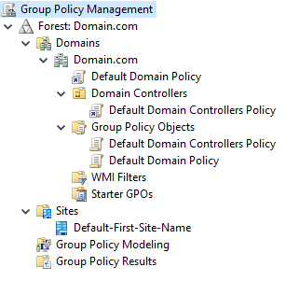
gpmc.msc
Allows you to look at Group Policy objects (GPOs), organizational units (OUs), domains, and sites
Can configure GPOs for domain

Slide 8
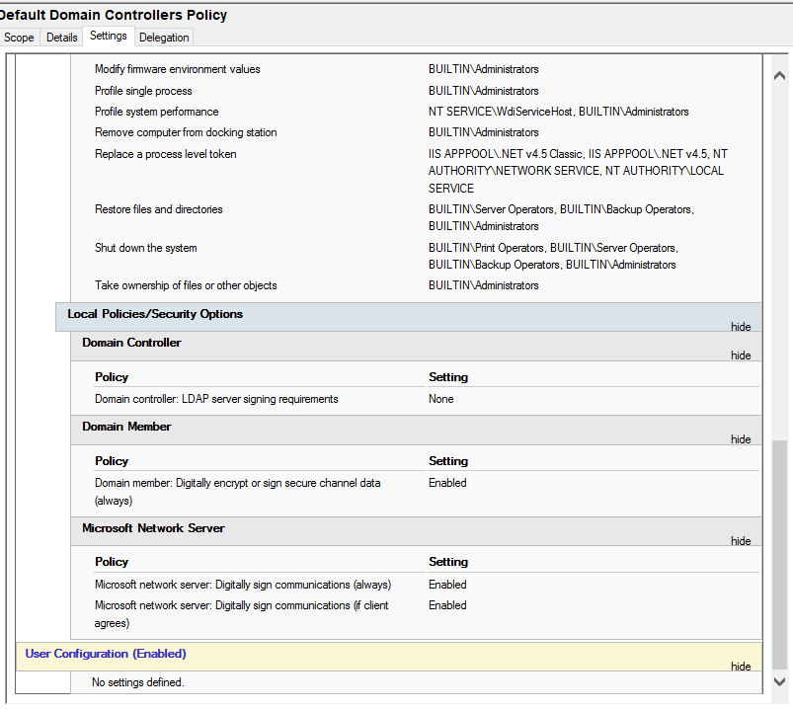
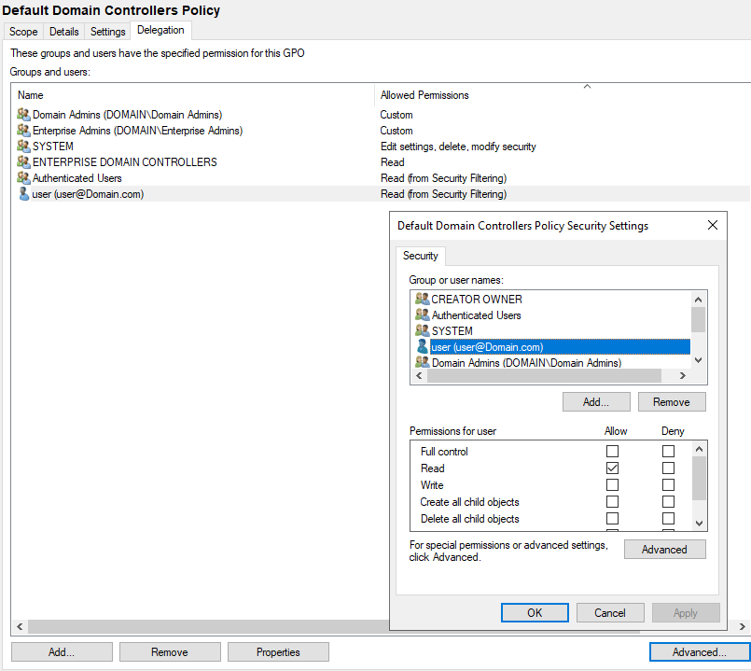
Change Permissions
Configure settings

Slide 9
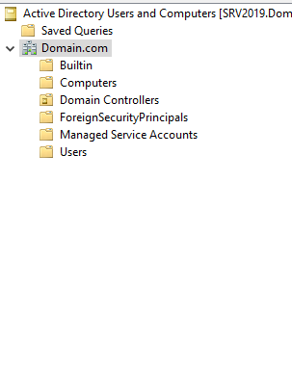
dsa.msc
Allows you to see all the users, computers, etc. in your domain

Slide 10
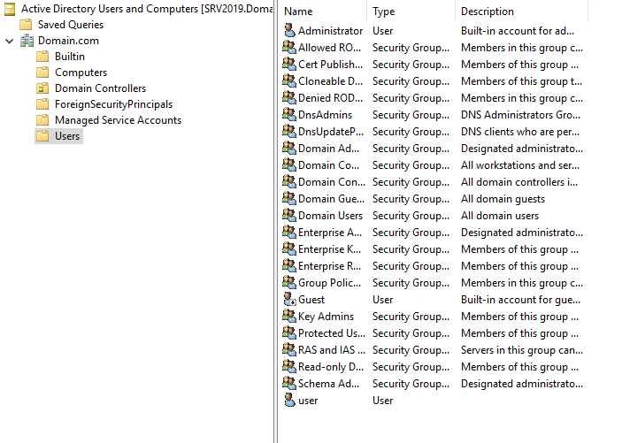
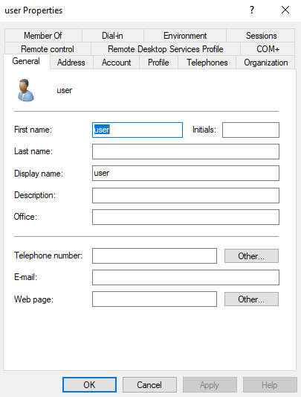

Slide 11
Security
Resources:
https://docs.microsoft.com/en-us/windows-server/identity/ad-ds/plan/security-best-practices/best-practices-for-securing-active-directory

